Slide 1
Computer Architecture: Memory Types
Dr. Colin O’Flynn

Slide 2
Lectures
How does a program run on a machine?
How do you compile from high-level code to machine code?
How does the machine run? (Control Flow)
How does the machine store data?
How does the machine interface using buses?
What does it mean to have “allowed” memory?
Why is some memory faster & slower?
How does the machine speed up data access?

Slide 3
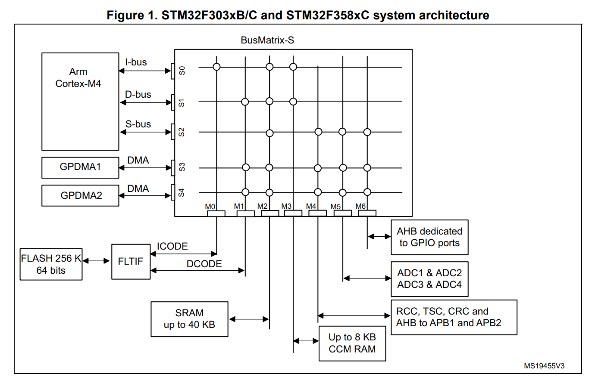
Why would a bus not respond on time?
Prior lectures looked at busses
This lecture will look in detail at why we have many choices.

Slide 4
Properties of Memory
Speed
Density
Cost
Volatility

Slide 5
Comparison of Memory Types
 | Speed | Density | Cost | Volatility
Static RAM | High | Low | High | Requires Power
Dynamic RAM | Very High | High | Medium | Requires Active Logic
Flash | Slower | Very High | Low | >10 year without power

Slide 6
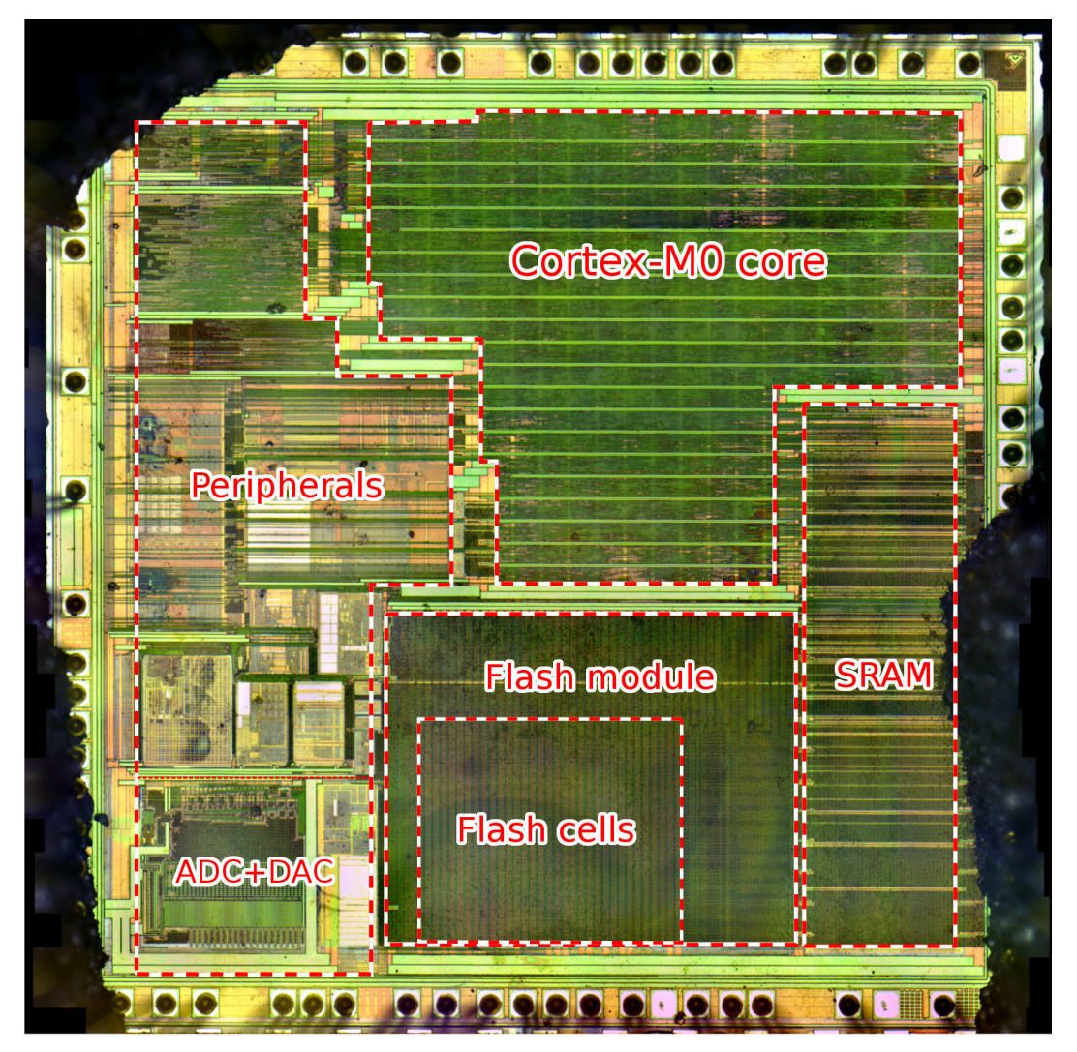
Typical Small Microcontroller
STM32F051R8T6:
Cortex-M0 (simpler than M4 we are using)
64 Kbyte Flash
8 Kbyte SRAM
https://www.usenix.org/system/files/conference/woot17/woot17-paper-obermaier.pdf

Slide 7
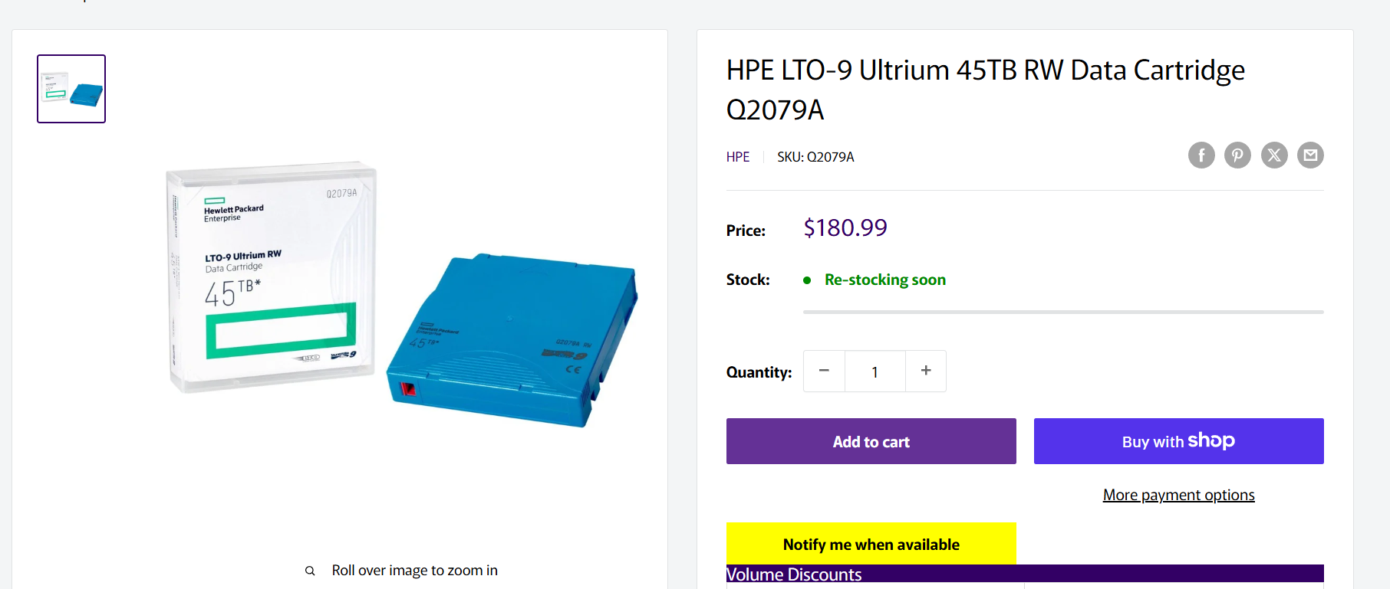
Why Tapes are Still used in 2026
Speed: VERY SLOW Density: VERY HIGH Cost: VERY LOW Volatility: VERY LONG

Slide 8
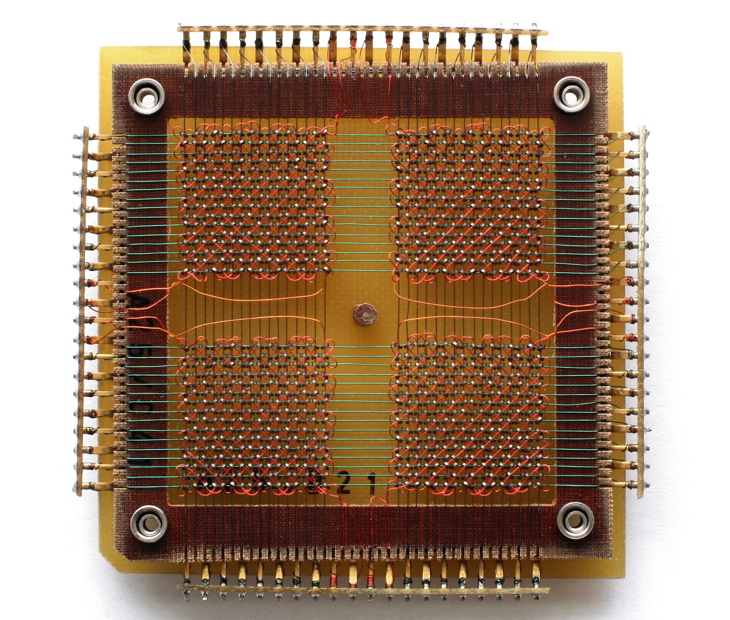
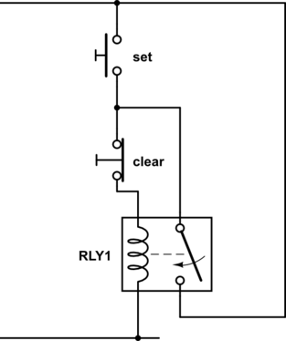
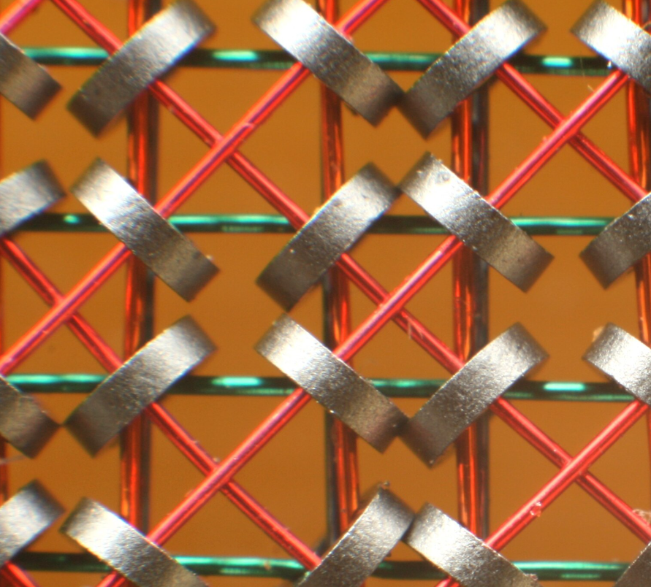
History of Computer Memory

Slide 9
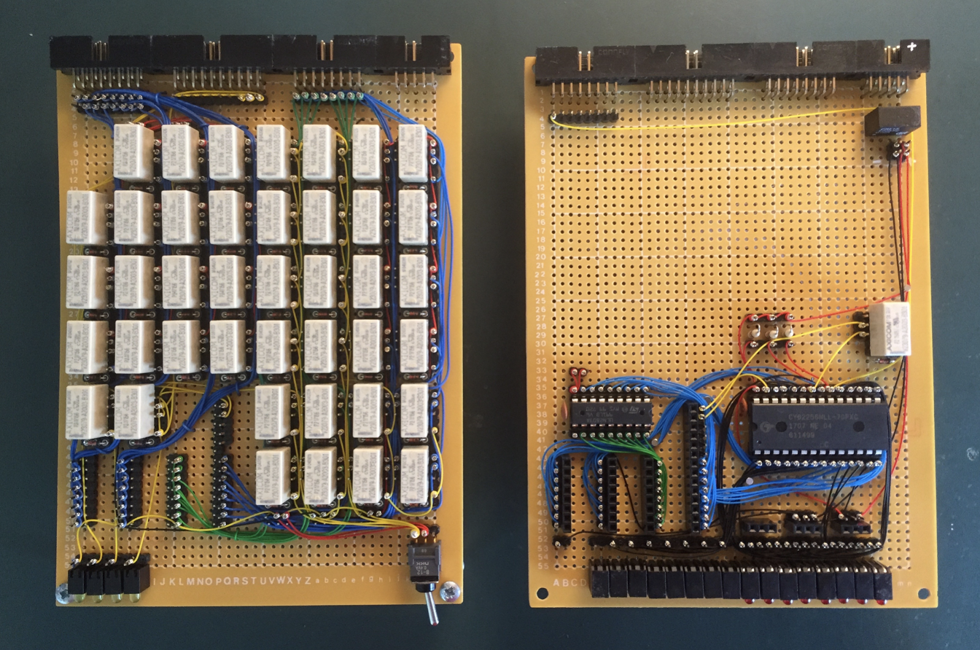
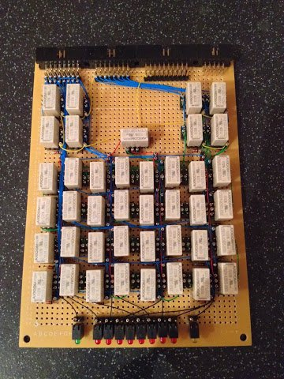
Modern Relay Computers
Modern SRAM chips used in combination with MANY relays..
https://www.relaycomputer.co.uk/
https://web.cecs.pdx.edu/~harry/Relay/RelayPaper.pdf

Slide 10
Core Memory Arrays
The method of arraying core (magnetic) based arrays will follow closely our usage of EEPROM/FLASH Arrays.
Including ideas of “sensing” a stored charge, and “programming”

Slide 11
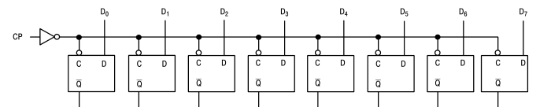
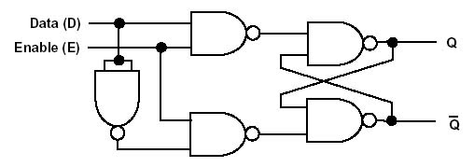
Registers

Slide 12
Storage Arrays
D7
D6
D5
D4
D0
Wordlines (Rows)
D7
D6
D5
D4
D0
D7
D6
D5
D4
D0
Bitlines (Columns)

Slide 13
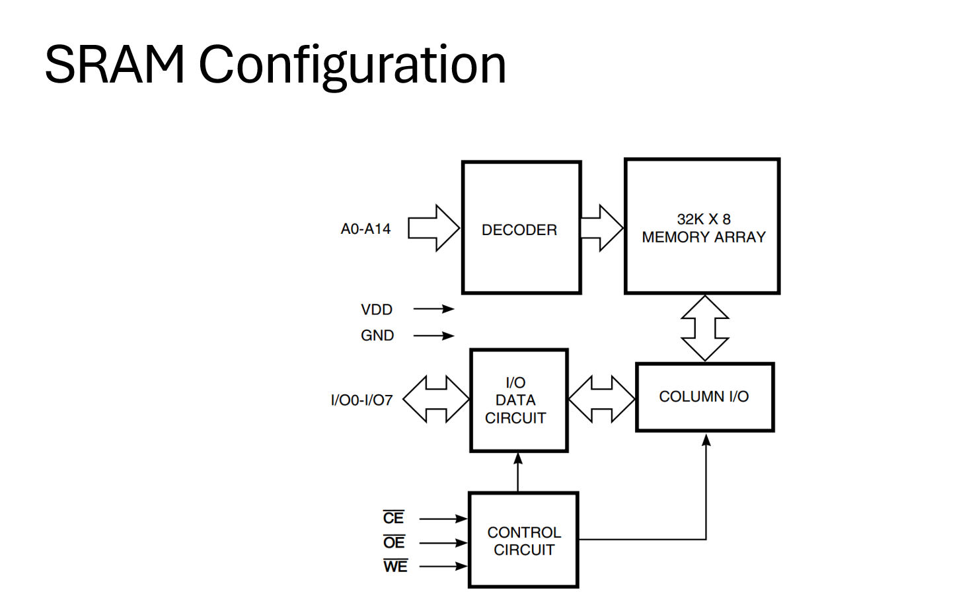
Static RAM (SRAM) Access
From Lecture 4.1: Memory Busses
Wordline = Decoder selects word
Column I/O = Data Bits

Slide 14
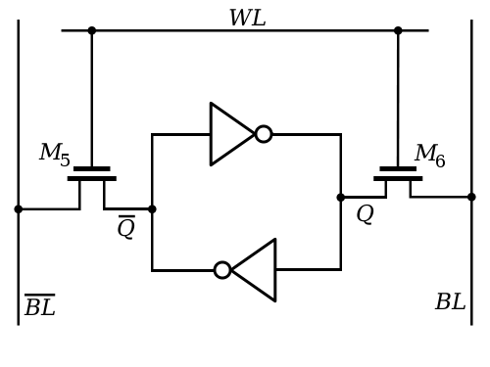
Static RAM (SRAM) Cells
SRAM cells have two inverters
Bitlines (read) are read differentially
A write simply drives a strong signal that overpowers the inverter storage
A read uses a weak current to detect the voltage

Slide 15
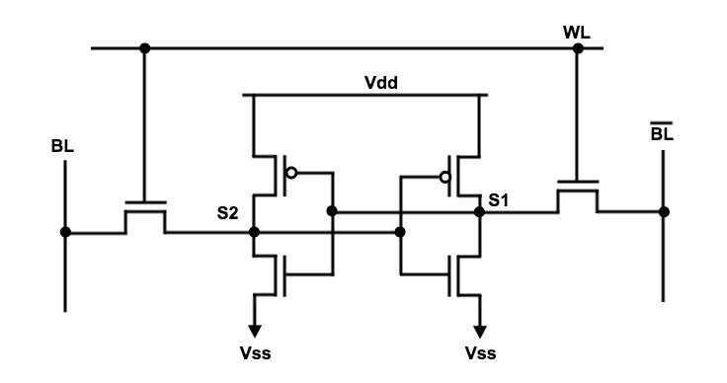
Static RAM (SRAM) Cells
Implementation has 6 transistors
(6 transistors = 1 bit)
More transistors needed in some situations (lower voltages etc)

Slide 16
SRAM Access
From Lecture 4.1: Memory Busses
Random Access: simply enable the wordline and the bits are available.
No clock needed!

Slide 17
SRAM Memory Properties
Equal access time across memory array
Read & write are similar in access
Unlimited read/write cycles
Requires power to maintain data
Uses 6 transistors per bit (minimum)

Slide 18
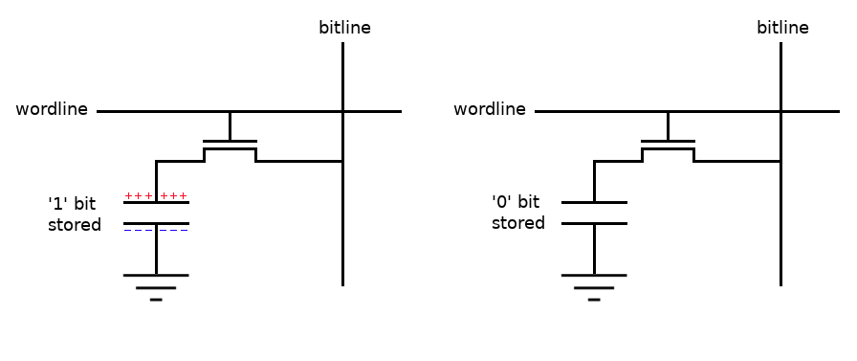
Dynamic RAM (DRAM)
DRAM stores the charge on a capacitor (not using a logic element)
DOWNSIDE: Reads are destructive, capacitor will discharge quickly over time (needs a “refresh”)

Slide 19
DRAM Fundamentals
Dynamic RAM (DRAM) requires a controller that is actively working to refresh rows
Typically in range of every ~32 – 64 mS
The savings per cell are so high that this extra complexity is worth it above some storage size
Refresh cycles mean:
Impossible to have 100% bus usage
Some intelligence in read/buffering/refresh cycles can be needed

Slide 20
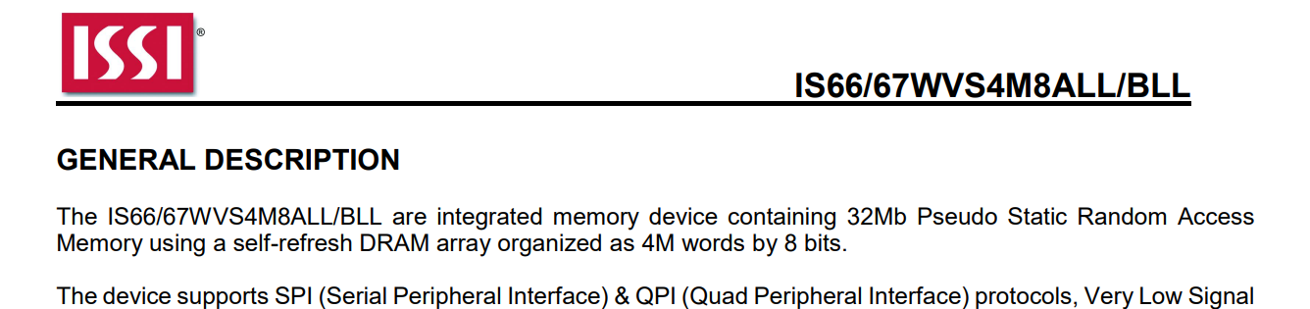
Sidenote: PSRAM
You may run across something called “Pseudo SRAM” (PSRAM)
Tries to combine SRAM “ease of use” with DRAM cost/density

Slide 21
e.g., SRAM vs. PSRAM vs. DDR Memory Costs
Lets say you wanted to add memory to your design:
Type | Amount | Speed (approx.) | Part Number | Price
SRAM | 128 KByte | 22 MHz | CY62128ELL-45SXI | $4
SRAM | 4 MByte | 20 MHz | AS6C3216A-55TIN | $43
DRAM | 32 MByte | 143 MHz | AS4C16M16SA-7TCN | $7
DRAM | 128 MByte | 800 MHz | IS43TR16640C-125JBLI | $9
PSRAM | 8 MByte | 50 MHz | IS66WVR8M8FALL-104NLI | $8
NOTE: Many subtilties hidden, giving you “order of magnitude” only

Slide 22
DRAM Memory Properties
Varied access time
Read & write are similar in access
Unlimited read/write cycles
Requires power AND activity to maintain data
Uses 1 transistor + 1 capacitor per bit (minimum)

Slide 23
EEPROM / FLASH
How do we store data that is non-volatile in computer systems?
Electronically Erasable Programmable Read Only Memory (EEPROM) & Flash memory are two common technologies you will see
They both use the same idea – a floating gate, but with slightly different implementations

Slide 24
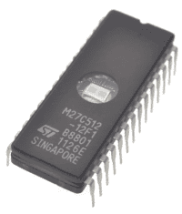
Historical Interests: EPROM
EPROM = Erasable Programmable Read Only Memory
Some of our original embedded systems used these – required a long (5-15 min) UV exposure to erase
Very annoying for debugging!

Slide 25
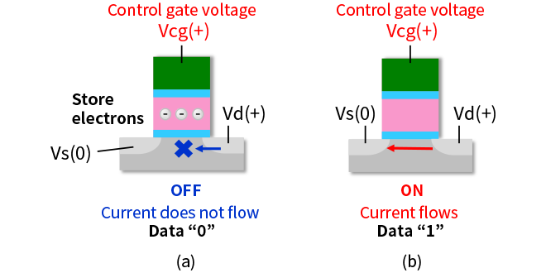
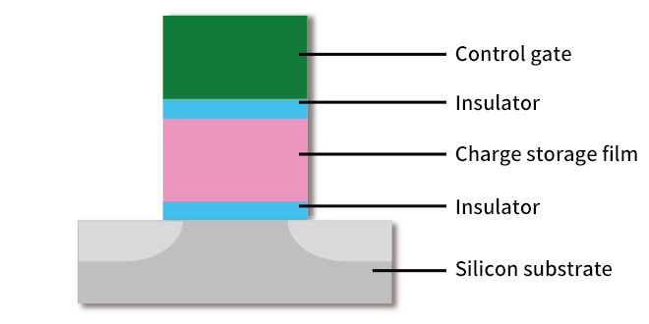
Floating Gate Storage - Reads

Slide 26
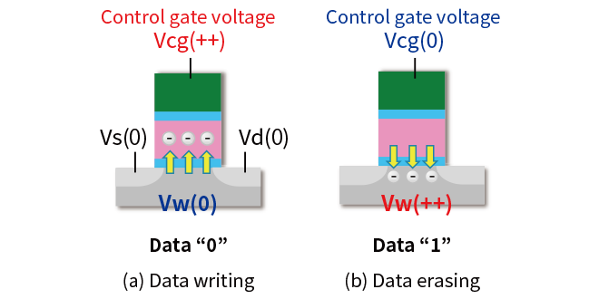
Floating Gate Storage - Writes

Slide 27
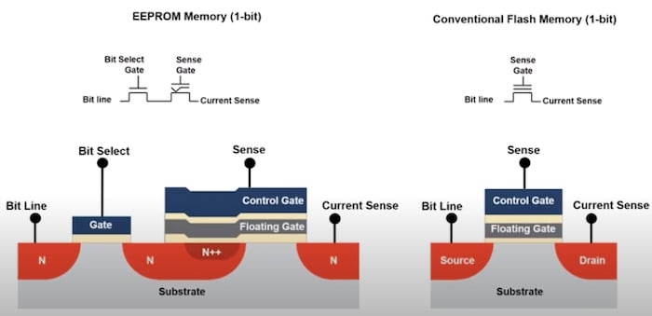
EEPROM vs. Flash
EEPROM has an additional select gate.
This allows erase/read/write

Slide 28
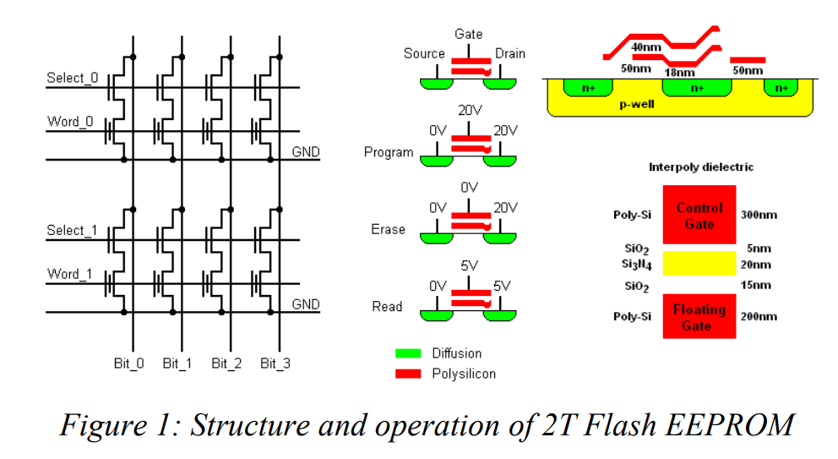
Read/Program Voltage Notes

Slide 29
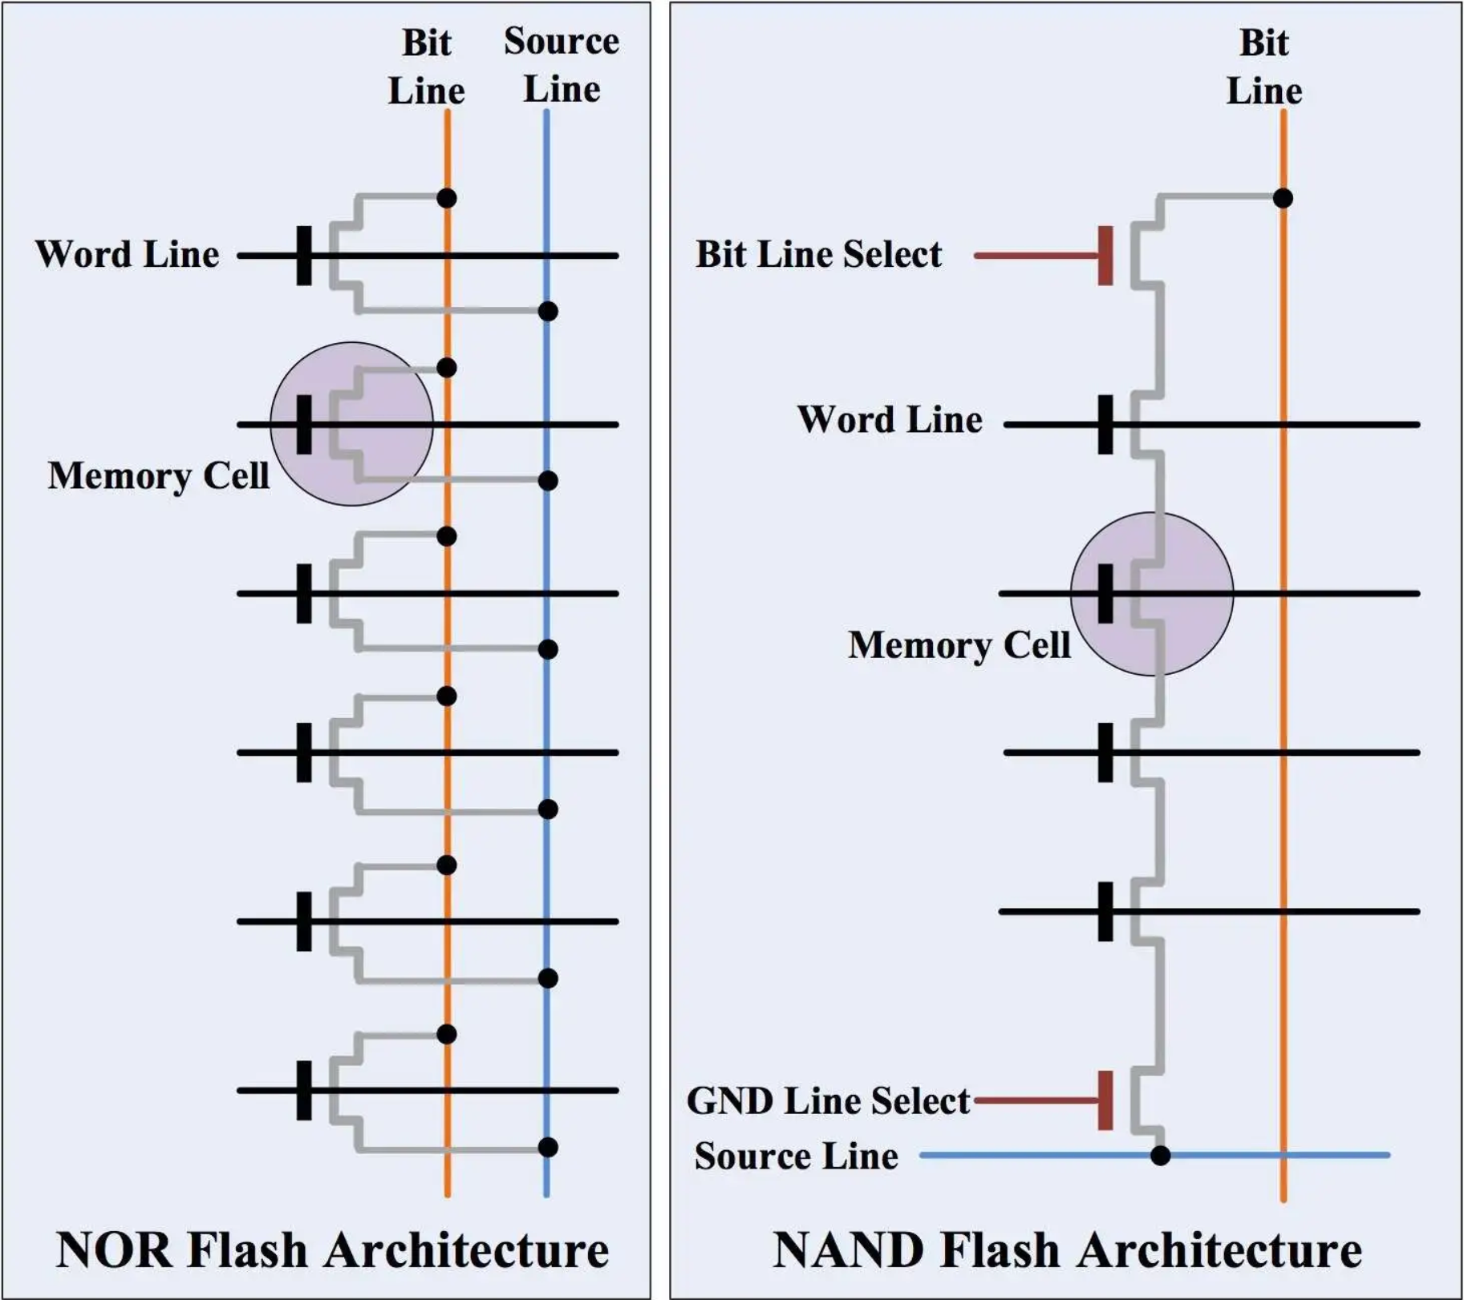
Flash: NOR vs NAND
Flash memory saves the select gate.
Two different organizations:
NOR allows per-bit output
NAND reduces connection (higher density) but more likely to have errors
NOR = Microcontroller flash
NAND = SSD, SD Card, etc
https://www.embedded.com/flash-101-nand-flash-vs-nor-flash/

Slide 30
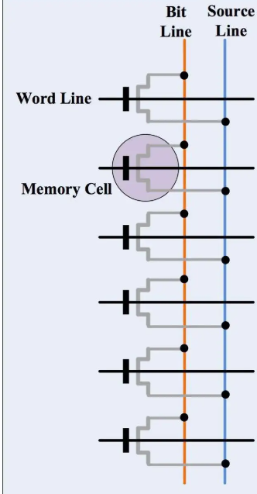
e.g., NOR Bitline / Wordline
Bit 0
Bit 1
Bit 2
Bit 3
Bit 4
Bit 5

Slide 31
Flash Memory Pages
Flash memory normally has pages that define a single “block”:
That block is always read & written together
Used as it improves density
To program flash memory:
Entire page erased to a “1”
Single bits can be programmed to a “0”
Normally a page is written at once, but you can always program individual bits to “0” later

Slide 32
Flash Memory Writes
If you needed to change a single byte:
Read FLASH page to a buffer
Change the required byte
Erase entire FLASH page
Write entire FLASH page

Slide 33
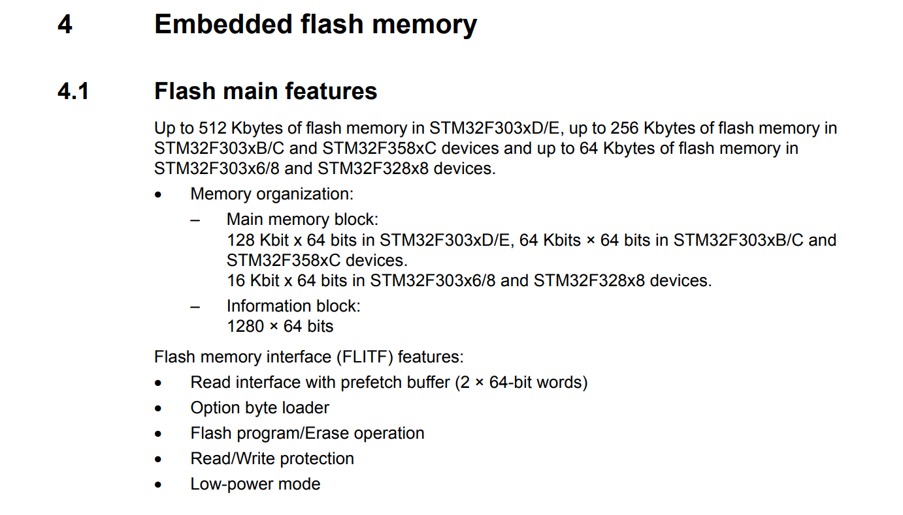
Flash Memory Organization (Width)
In memory with sequential access being common, having extra width is very useful.
Typical in embedded devices (32-bit busses) to see 64-bit or 128-bit (2 or 4 words).
Think e.g., typical instruction flow being linear

Slide 34
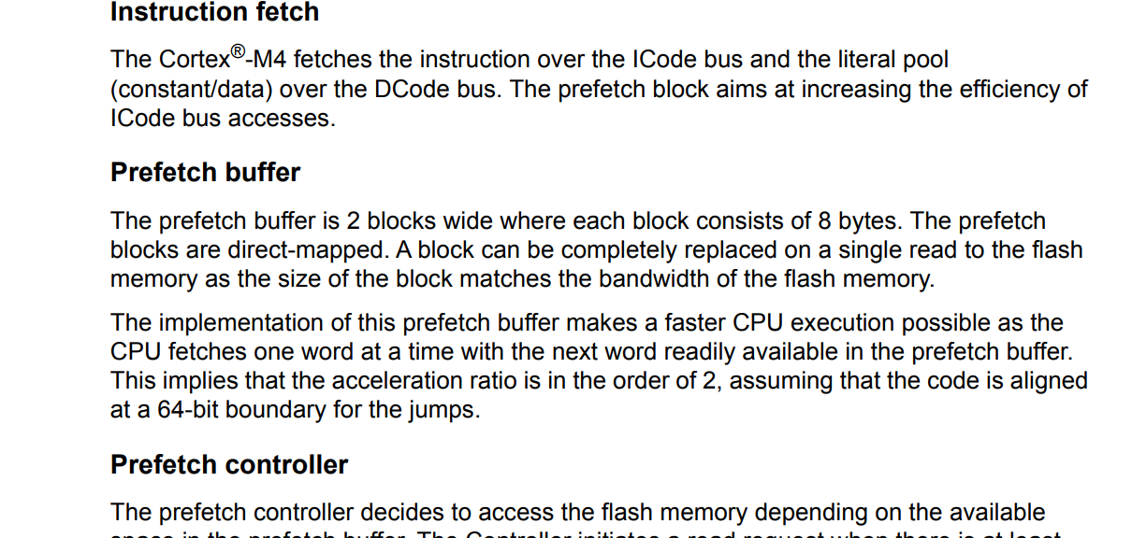
Flash “Accelerator”

Slide 35
Flash Timing Demo
Here is some demo code with 3 examples:
Running from SRAM
Running from Flash (normal code style)
Running from Flash (“jumpy” code that requires more loads)
b step1 step1: adds ... b step2 step2: eors ... b step3 step3: adds ... subs ... bne loop
adds r1, r1, r2 eors r2, r2, r1 adds r2, r2, #3 subs r0, r0, #1 bne loop

Slide 36


<Live Demo>
Compile project with:
slides_4_3_memoryspeed.c
slides_4_3_loops.s
Compile with “Release” (Optimizations on)
Slow CPU Speed (Flash faster than CPU)
High CPU Speed (Flash slower than CPU)

Slide 37
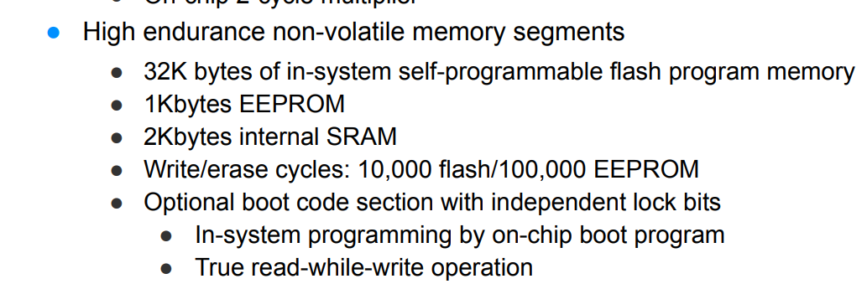
Flash Cycles
SRAM/DRAM have “unlimited” lifetimes
Flash/EEPROM have a limited number of cycles
Each time the gate charge is erased/written slowly causes additional breakdown
Manufacturer can adjust specifications to provide different user requirements. Trade-off between density & reliability/cycles.
Be aware these specs are often at full temp range (you may see 10-1000x more cycles in practice)
E.g., from AtMega328P Datasheet:

Slide 38
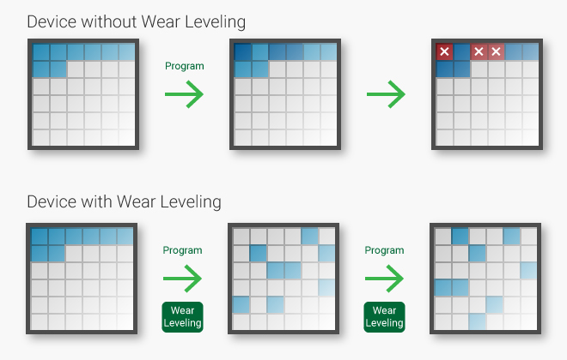
Wear Leveling
Cycle life is per cell.
E.g., if you had a counter that increments every 1 second

Slide 39
Wear Leveling Example
Writing 1 byte of 256 byte every second:
w/o Wear Leveling (same byte)
86 400 cycles per day
2 592 000 cycles per month
~1.1 day lifespace of device @ 100K cycles
w/ Wear Leveling (spread among 256 bytes)
337 cycles per day
10 125 cyclers per month
~10 month lifespan of device @ 100K cycles

Slide 40
Flash/EEPROM Memory Properties
Equal access time across memory array
Read & write are very different
Write requires per-page access
Unlimited read, limited write cycles
Data is non-volatile (maintained without power)
Uses 1 transistor + floating gate per bit (minimum)

Slide 41
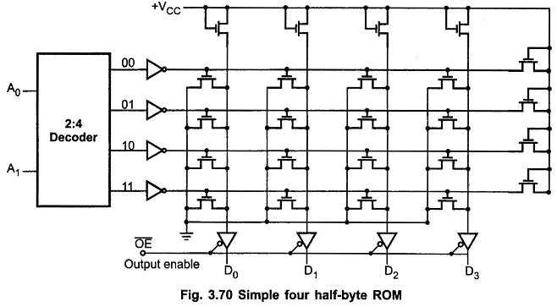
ROM
Transistors are either present or absent at interconnections
Transistor present pulls line LOW
Used for permanent data defined at manufacture time

Slide 42
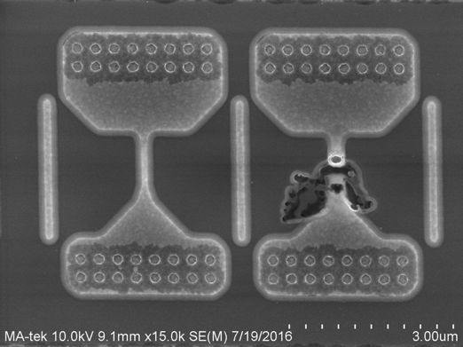
E-Fuses
Programmable “in the field”.
Requires higher voltages/current to blow a physical link.
Often used for security keys and other “cannot change” things
Different technologies for implementation

Slide 43
Emulated ROM, Flash, and Fuses
Some devices have only flash memory
They will attempt to “emulate” the missing bits using control logic:
“Fuses” are in Flash

Slide 44
Summary of Memory Types
Different memory types have different:
Speed (access speed)
Density
Organization
Capabilities (read vs write sizes)
Storage lifetime
Complexity
Similar organization (wordline vs. bitlines) in most memories
SRAM and Flash/EEPROM in all embedded systems
DRAM normal in larger embedded systems (Linux/Android)

